Slide 1
Chapter 5
Computer
Organization

Slide 2
OBJECTIVES
After reading this chapter, the reader should
be able to:
Distinguish between the three components of a computer
hardware.
List the functionality of each component.
Understand memory addressing and calculate the number
of bytes for a specified purpose.
Distinguish between different types of memories.
Understand how each input/output device works.
Continued on the next slide

Slide 3
OBJECTIVES (continued)
Understand the systems used to connect different
components together.
Understand the addressing system for input/output
devices.
Understand the program execution and machine cycles.
Distinguish between programmed I/O, interrupt-driven
I/O and direct memory access (DMA).
Understand the two major architectures used to define
the instruction sets of a computer: CISC and RISC.

Slide 4
Contents
5.1 Central processing Unit(CPU)
5.2 main memory
5.3 Input/Output
5.4 Subsystem Interconnection
5.5 Program Execution
5.6 Two different Architectures
Key Terms
Summary

Slide 5
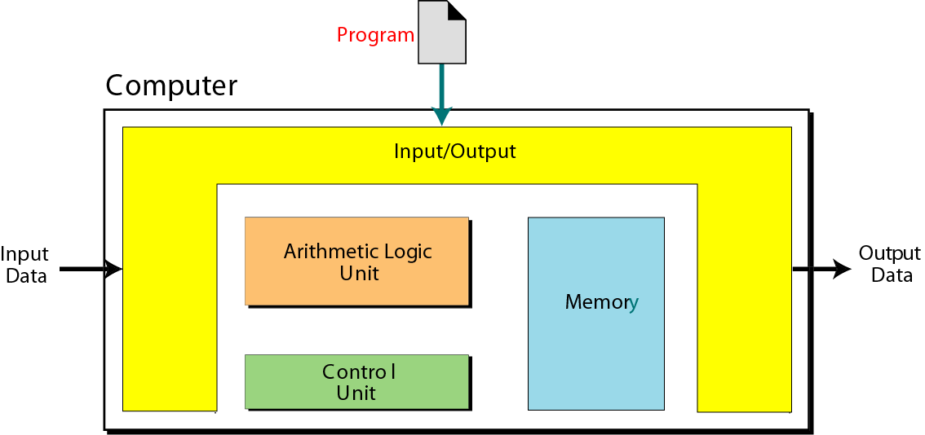
von Neumann model
How to connect different components?

Slide 6
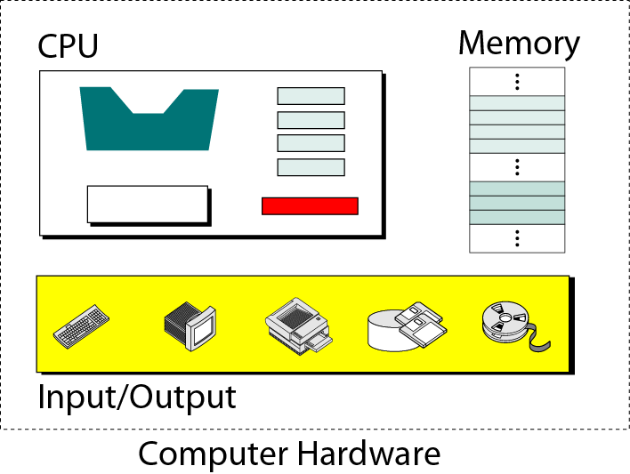
Figure 5-1
Computer hardware (subsystems)

Slide 7
5.1
CENTRAL
PROCESSING
UNIT
(CPU)

Slide 8
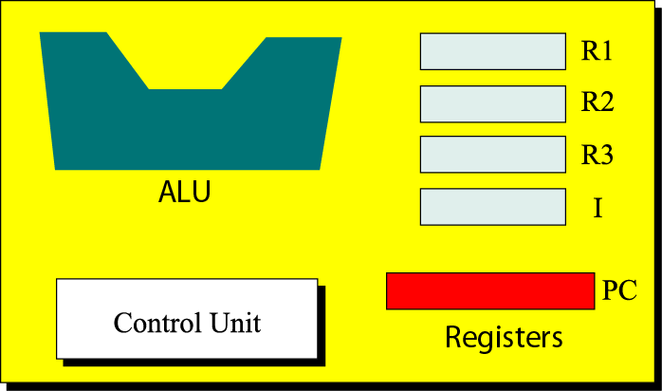
Figure 5-2
CPU

Slide 9
ALU
The arithmetic logic unit(ALU) performs
Arithmetic Operation;
Logic Operation.

Slide 10
Registers
Registers are fast stand-alone storage locations that hold data temporarily.
Data Register: R1 R2 R3
Instruction register: I
Program Counter: PC

Slide 11
Control Unit
Controlling is achieved through wires that can be on or off.

Slide 12
5.2
MAIN MEMORY

Slide 13
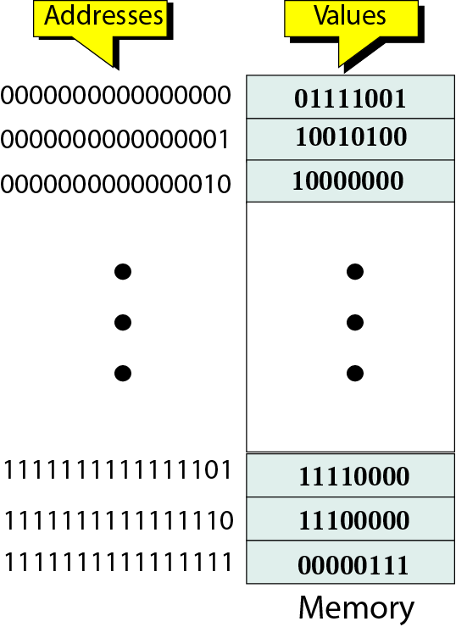
Figure 5-3
Main memory
Address space

Slide 14
Table 5.1 Memory units
Unit
-----------
kilobyte
megabyte
gigabyte
terabyte
petabyte
exabyte
Exact Number of bytes
-----------------------
2¹⁰ bytes
2²⁰ bytes
2³⁰ bytes
2⁴⁰ bytes
2⁵⁰ bytes
2⁶⁰ bytes
Approximation
------------
10³ bytes
10⁶ bytes
10⁹ bytes
10¹² bytes
10¹⁵ bytes
10¹⁸ bytes
What’s the difference between a word and a byte?
word: Data are transferred to and from memory in groups of bits called words.
Byte: 8 bits word.

Slide 15

Note:
Memory addresses are defined using
unsigned binary integers.

Slide 16
Example 1
A computer has 32 MB (megabytes) of memory. How many bits are needed to address any single byte in memory?
Solution
8B memory need 3bits to address.
The memory address space is 32 MB, or 2²⁵ (2⁵ x 2²⁰). This means you need
log₂ 2²⁵ or 25 bits, to address each byte.

Slide 17
Example 2
A computer has 128 MB of memory. Each word in this computer is 8 bytes. How many bits are needed to address any single word in memory?
Solution
The memory address space is 128 MB（ 2²⁷）. However, each word is 8 (2³) bytes, which means that you have 2²⁴ words. This means you need log₂ 2²⁴ or 24 bits, to address each word.

Slide 18
Memory Types
Two types of memory : RAM and ROM.
RAM(random access memory):
(1)RAM can be read from and written to by the user.
(2)RAM is volatile.
SRAM(static RAM):flip-flop gates, no need for refreshing.
DRAM(dynamic RAM):capacitor.need to be refreshed periodically.

Slide 19
Memory Types
ROM:(Read-only memory)
(1)The user is allowed to read but not write to ROM.
(2)ROM is nonvolatile.
PROM:
EPROM:
EEPROM:

Slide 20
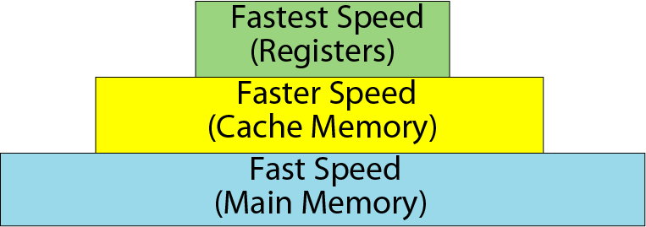
Memory hierarchy
Figure 5-4

Slide 21
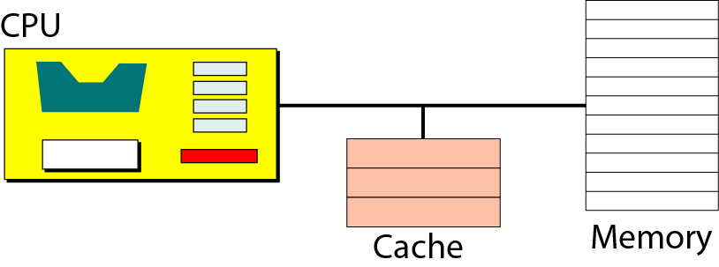
Cache
Figure 5-5

Slide 22
5.3
INPUT / OUTPUT

Slide 23
Nonstorage devices
Input/Output devices can be divided into two broad categories:nonstorage and storage devices.
Nonstorage devices allow the CPU/memory to communicate with the outside world but they can not store information.

Slide 24
Storage devices
Storage devices, although classified as I/O devices, can store large amounts of information to be retrieved at a later time.
We categorize them as either magnetic or optical.

Slide 25
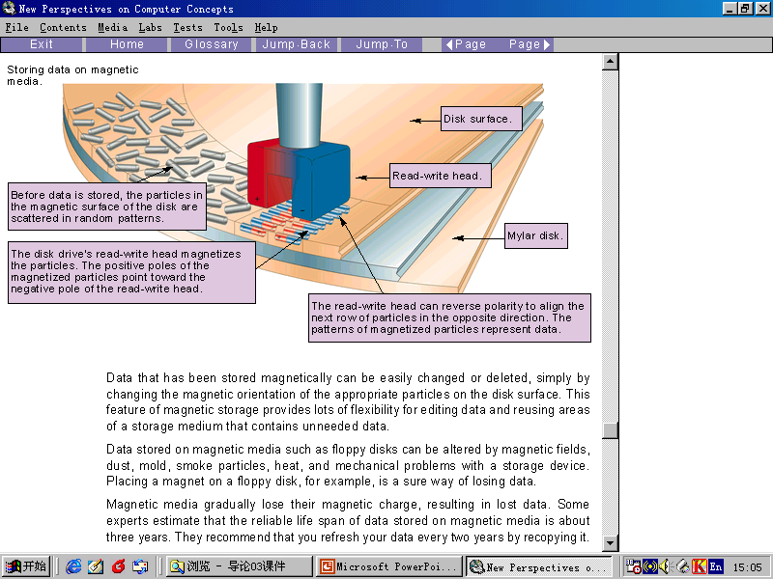
Magnetic Storage Devices

Slide 26
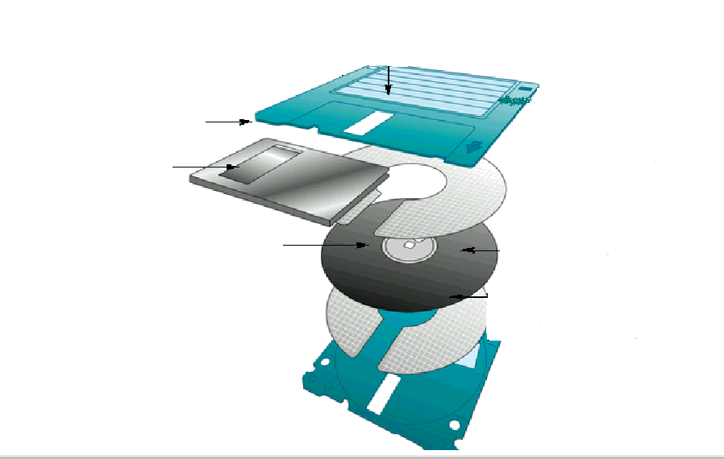
Magnetic Storage Devices

Slide 27
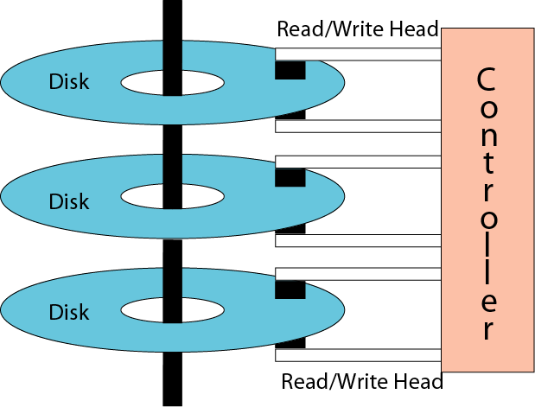
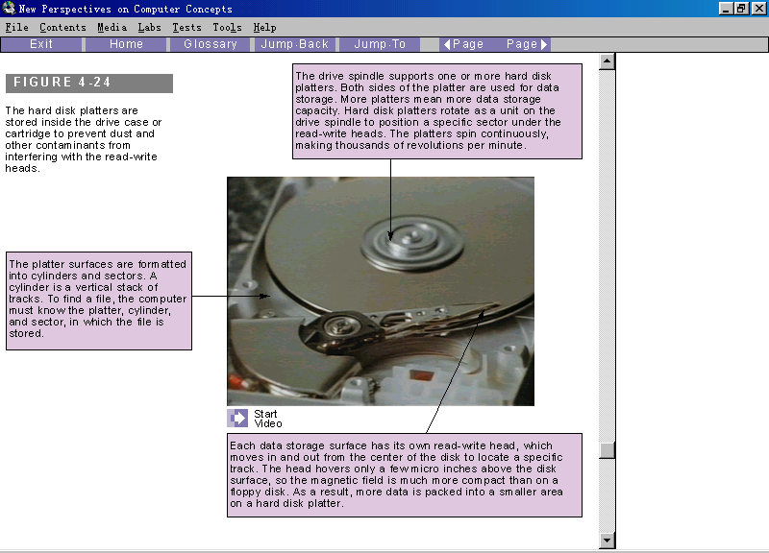
Physical layout of a magnetic disk
Figure 5-6

Slide 28
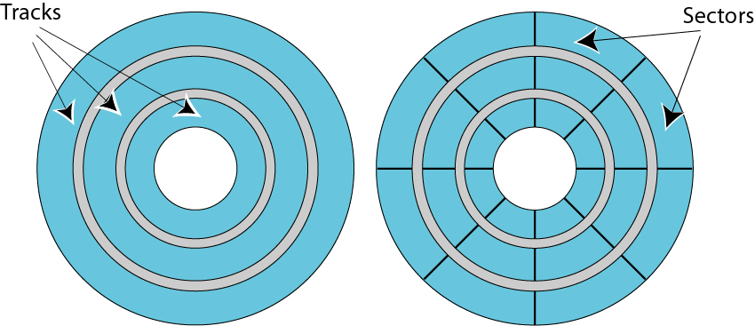
Figure 5-7
Surface organization of a disk

Slide 29
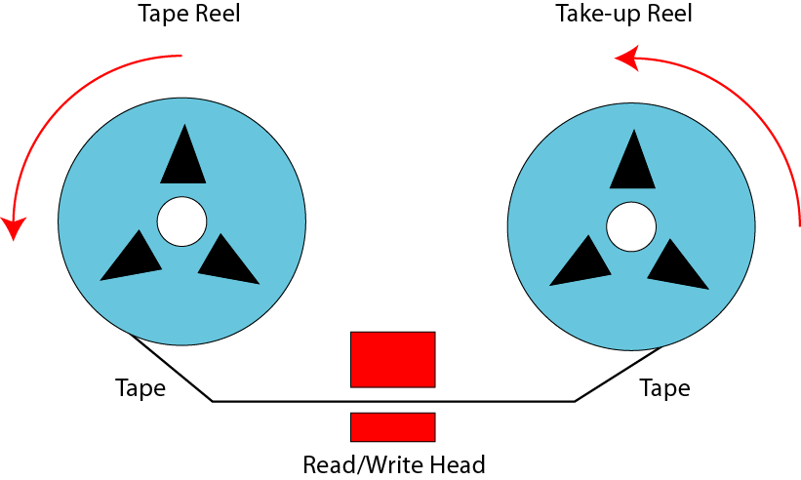
Figure 5-8
Mechanical configuration of a tape
磁带卷轴
收带卷轴

Slide 30
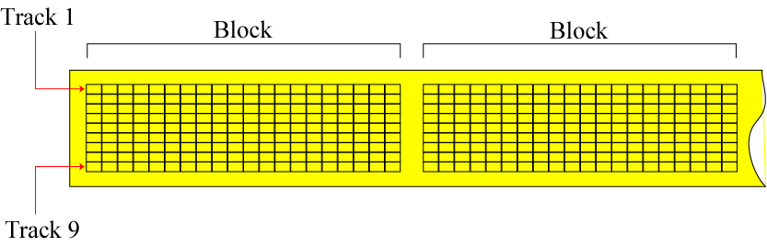
Surface organization of a tape
Figure 5-9

Slide 31
Optical Storage Devices
CD-ROM
CD-R
CD-RW
DVD

Slide 32
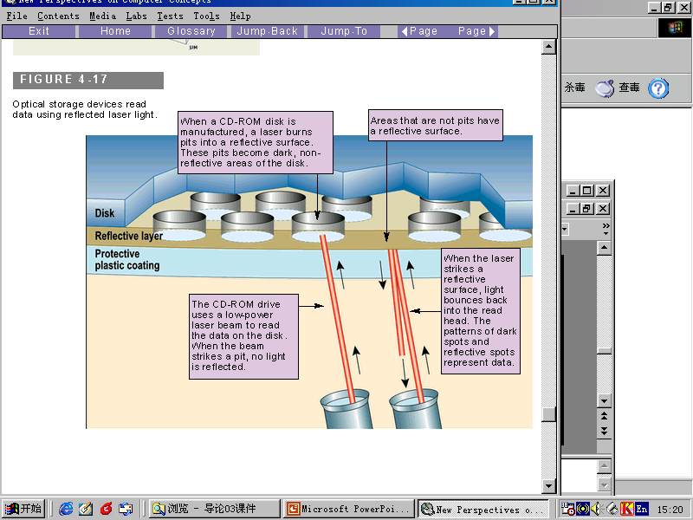
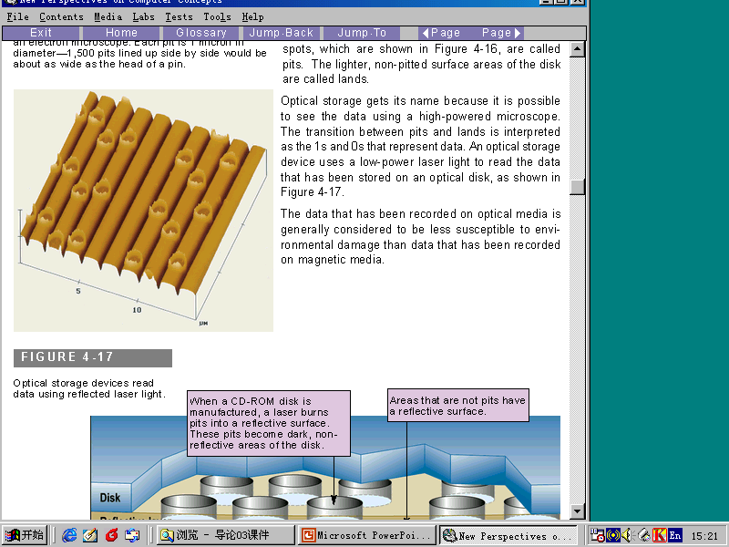

Slide 33
Table 5.2 CD-ROM speeds
Speed
------------
1x
2x
4x
6x
8x
12x
16x
24x
32x
40x
Data Rate
------------------------
153,600 bytes per second
307,200 bytes per second
614,400 bytes per second
921,600 bytes per second
1,228,800 bytes per second
1,843,200 bytes per second
2,457,600 bytes per second
3,688,400 bytes per second 4,915,200 bytes per second
6,144,000 bytes per second
Approximation
------------
150 KB/s
300 KB/s
600 KB/s
900 KB/s
1.2 MB/s
1.8 MB/s
2.4 MB/s
3.6 MB/s
4.8 MB/s
6 MB/s

Slide 34

Table 5.3 DVD capacities
Feature
---------------------------------
single-sided, single-layer
single-sided, dual-layer
double-sided, single-layer
double-sided, dual-layer
Capacity
------------
4.7 GB
8.5 GB
9.4 GB
17 GB

Slide 35
5.4
SUBSYSTEM
INTERCONNECTION

Slide 36
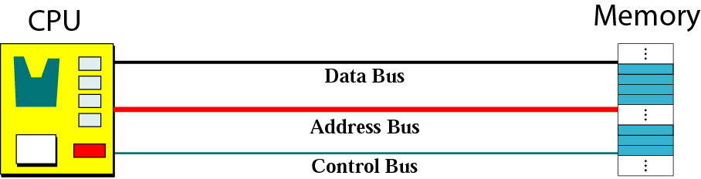
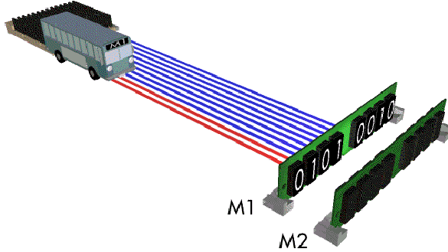
Connecting CPU and memory using three buses
Figure 5-14

Slide 37
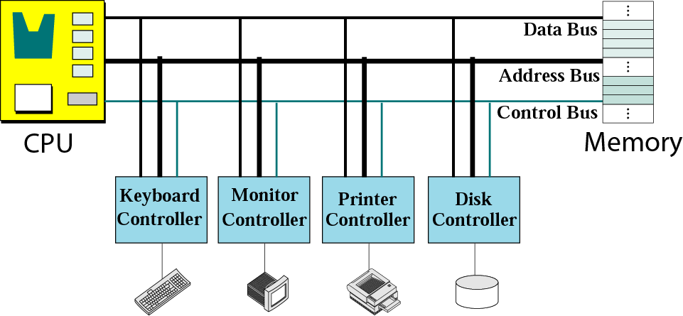
Connecting I/O devices to the buses
Figure 5-15

Slide 38
Controllers
Controllers or interface:can be a serial or parallel device.
A serial controller has only one wire connection to the device.
A parallel controller has several connections to the device so that several bits can be transferred at a time.

Slide 39
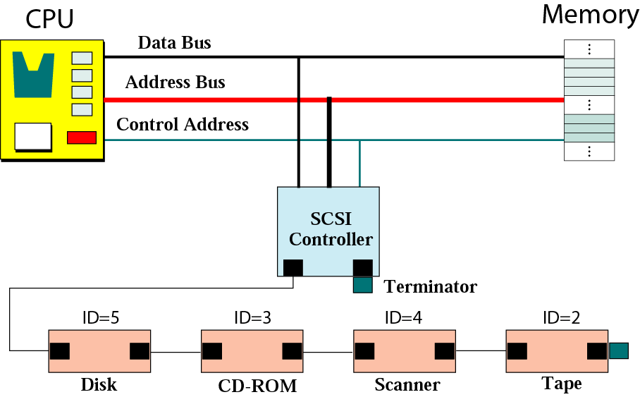
SCSI controller (small computer system interface)

Slide 40
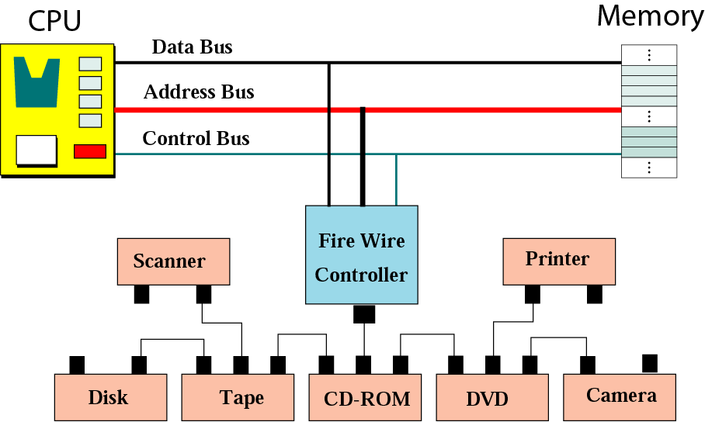
FireWire controller

Slide 41
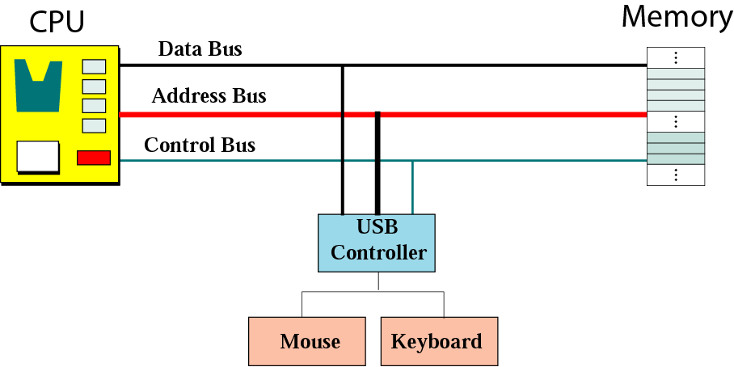
USB controller

Slide 42
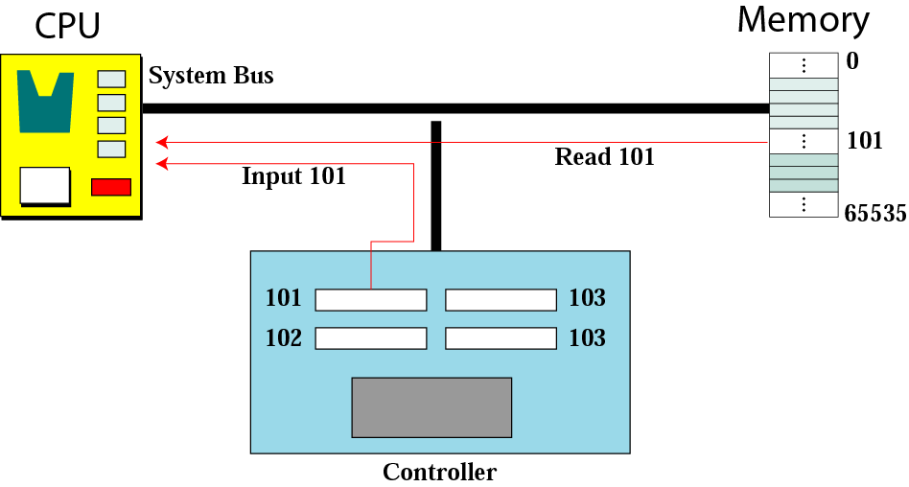
Isolated I/O addressing

Slide 43
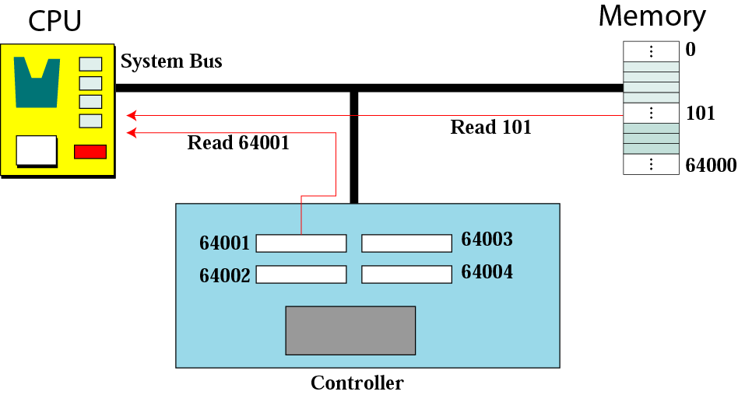
Memory-mapped I/O addressing

Slide 44
5.5
PROGRAM
EXECUTION

Slide 45
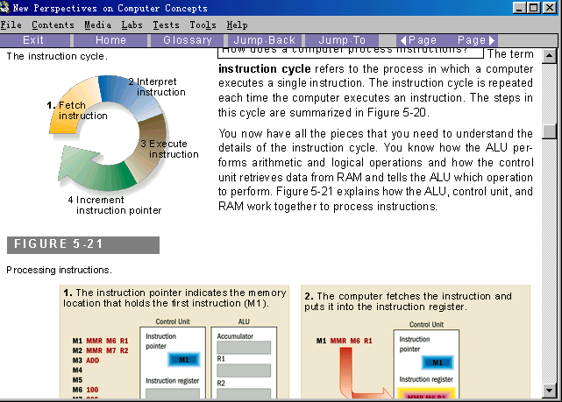
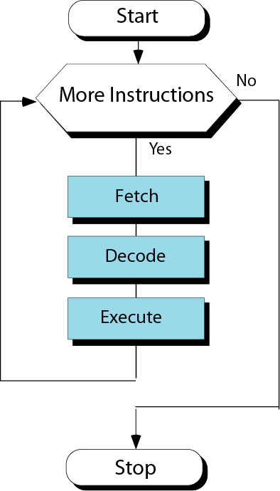
Machine cycle
4 Machine cycle
Figure 5-21
Steps of a cycle

Slide 46
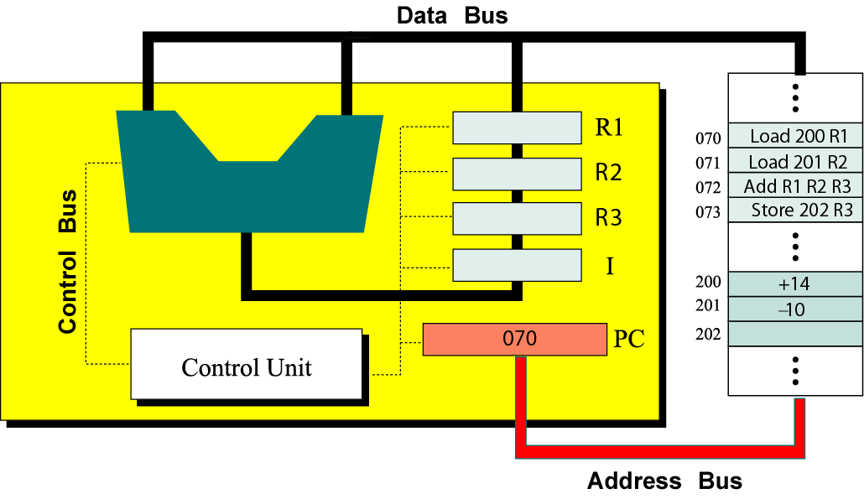
A Machine Cycle Example 1
Memory
Contents of memory and register before execution

Slide 47
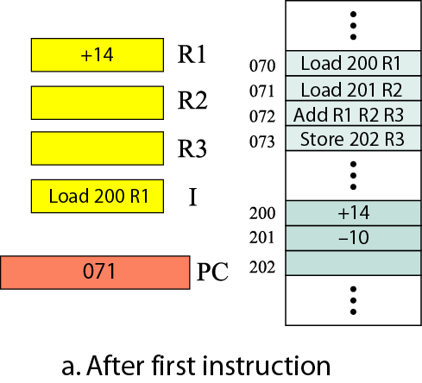
Contents of memory and registers after each cycle
Memory

Slide 48
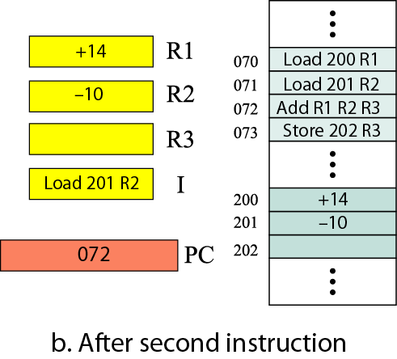
Contents of memory and registers after each cycle
Memory

Slide 49
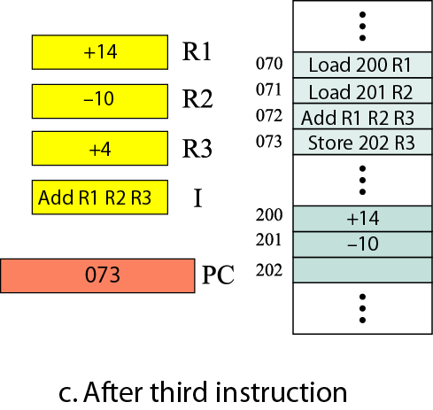
Contents of memory and registers after each cycle
Memory

Slide 50
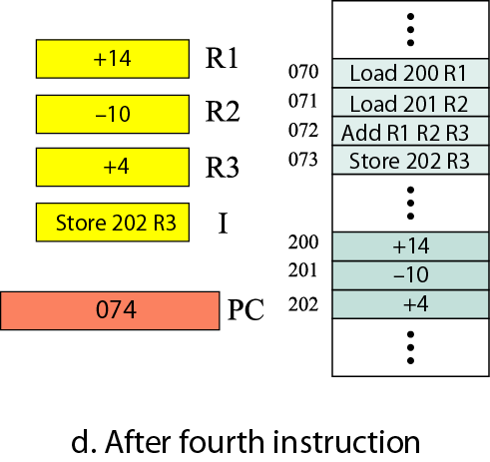
Contents of memory and registers after each cycle
Memory

Slide 51
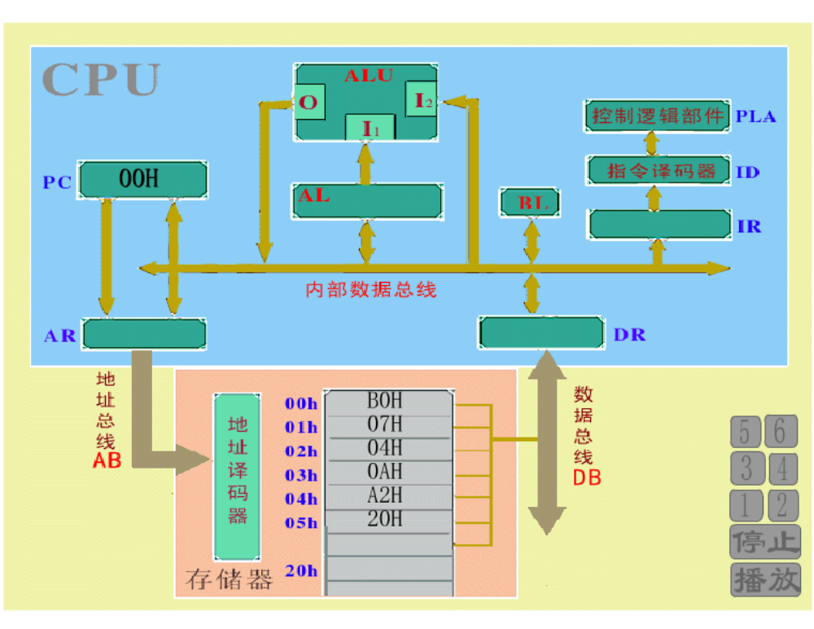
A Machine Cycle Example 2
MOV AL, 07H
ADD AL, 04H
MOV [20H], AL

Slide 52
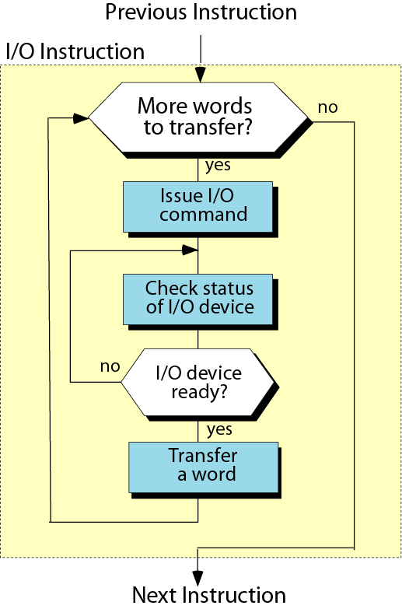
Programmed I/O
Figure 5-24

Slide 53
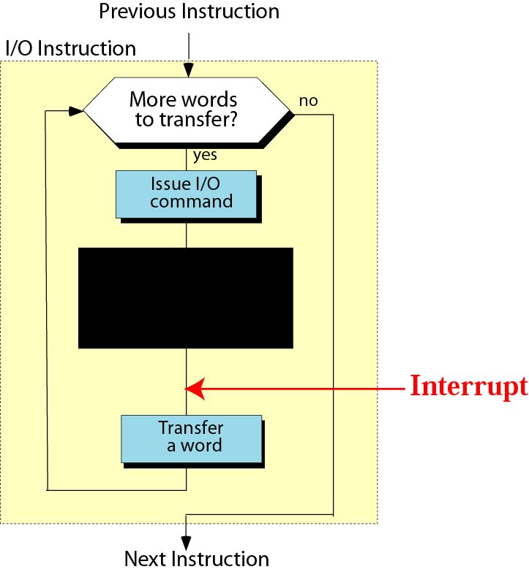
Interrupt-driven I/O
Figure 5-25

Slide 54
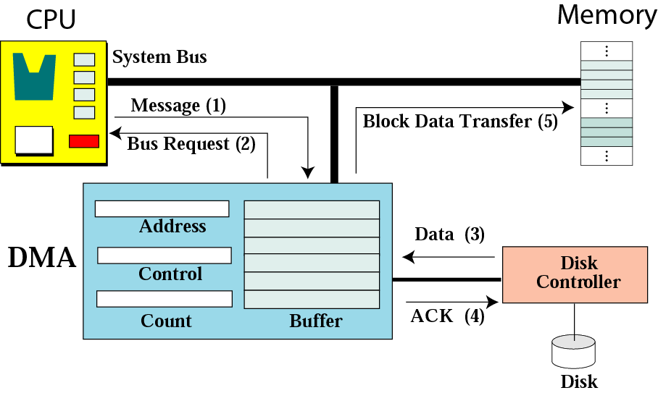
DMA connection to the general bus
Direct memory Access(直接存储器存取,DMA)

Slide 55
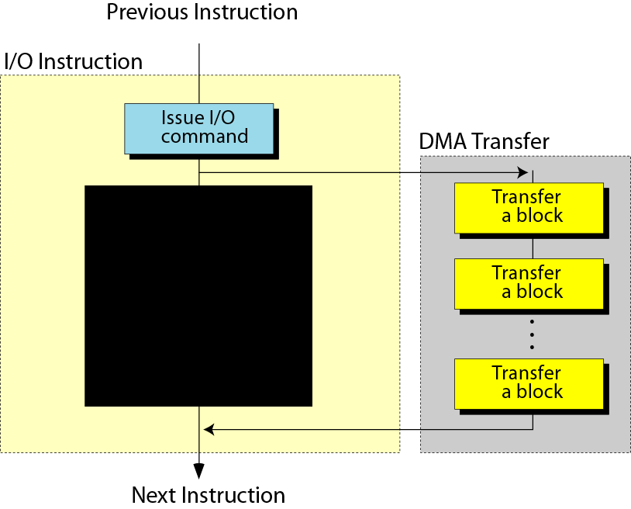
DMA input/output

Slide 56
5.6
TWO DIFFERENT
ARCHITECTURES

Slide 57
Two different architecture ---CISC and RISC
The strategy behind CISC (complex instruction set computer) architecture is to have a large set of instructions, including the complex ones.
The strategy behind RISC (reduced instruction set computer) architecture is to have a small set of instructions that do minimum number of simple operations.

Slide 58
Two different architecture
指令(instruction) 控制计算机执行特定的算术、逻辑或控制运算的命令。
一条指令可以分两部分：操作码(op code) 和地址码(operands).
0110 000010 000001
ADD REG2 REG1
CPU可以执行的全部指令称为Instruction set(指令集).

Slide 59
Two different architecture
操作码 | 操作 | 范例
INP | 将给定值放到指定内存 | INP 7 M1
MMR | 将指定内存中的值取到寄存器 | MMR M1 REG1
MAR | 将累加器中值取到指定寄存器 | MAR REG1
ADD | 两个寄存器中值相加，结果放在累加器中 | ADD REG1 REG2
JMP | 跳转到指定内存中的指令 | JMP P2
HLT | 停止程序执行 | HLT
一个简单的微机指令集（部分）

Slide 60
Key terms
CISC(complex instruction set computer)：复杂指令集计算机。
RISC(reduced instruction set computer)：精简指令集计算机。

Slide 61
Key terms
address bus(地址总线)
address space(地址空间)
arithmetic logic unit(算术逻辑单元，ALU)
bit pattern(位模式)
cache memory(高速缓冲存储器)
central processing unit(中央处理单元，CPU)
Compact disc read-only memory(只读光盘存储器，CD-ROM)

Slide 62
Key terms
compact disc recordable(可刻录光盘，CD-R)
compact disc rewritable(可重写光盘,CD-RW)
complex instruction set computer(复杂指令集计算机，CISC)
control bus(控制总线)
Control unit(控制单元)
data bus(数据总线)
data register(数据寄存器)

Slide 63
Key terms
digital versatile disc(数字多功能光盘，DVD)
direct memory access(可重写光盘,DMA)
dynamic RAM(动态RAM，DRAM)
execute(执行)
fetch(取指令)
firewire(火线)
Input/output controller（输入/输出控制器)
Input/output subsystem(输入/输出子系统)

Slide 64
Key terms
instruction register(指令寄存器)
interrupt driven I/O(中断控制输入输出)
isolated I/O(I/O独立寻址)
machine cycle(机器周期）
magnetic disk(磁盘)
main memory(主存)
Memory mapped I/O(存储器映射寻址)

Slide 65
Key terms
Main memory(主存储器)：存储单元的集合。
Address(地址)：用来区别每一个存储单元的唯一的标识符。
Address space(地址空间)：所有在存储器中可标识的独立地址单元的总数。
Bit pattern(位模式)：由二进制数0和1组成的一个序列。

Slide 66
Key terms
Random access memory(随机存取存储器，RAM)：主存的主要组成部分。
volatile(易失性)
Static RAM(静态RAM)
flip-flop gate(触发器门电路)
Dynamic RAM(动态RAM)
capacitor(电容)

Slide 67
Key terms
Read-only memory(只读存储器，ROM)
programmable read-only memory (PROM):可编程只读存储器
Erasable programmable read-only memory (EPROM):可擦除可编程只读存储器
Electronically erasable programmable read-only memory (EEPROM):电可擦除可编程只读存储器

Slide 68
Key terms
Memory hierarchy:存储器的层次结构
Cache memory :高速缓冲存储器
80-20 rule：指计算机通常会花费80%的时间来读取20%的数据
□

Slide 69
Key terms
Input/output subsystem(输入输出子系统)：使计算机与外部世界进行沟通的设备的集合。
nonstorage device(非存储设备)
storage device(存储设备）
keyboard(键盘)
Monitor( 监视器)
Printer(打印机)

Slide 70
Key terms
Magnetic storage device(磁介质存储设备）
Magnetic disk(磁盘)
Read/write header(读写磁头）
Surface organization(表面结构)：track(磁道)、sector(扇区)
Data access(数据存取)

Slide 71
Key terms
performance( 性能)
Rotational speed(角速度)：磁盘的旋转速度
Seek time(寻道时间)：读写磁头寻找数据所在的磁道的时间。
Transfer time(传送时间)：将数据从磁盘移到CPU/内存所需要的时间

Slide 72
Key terms
Optical storage device(光介质存储设备）:使用激光技术来存取数据。
CD-ROM(compact disc read-only memory,只读光盘)
Master disc(主盘)：使用高能红外激光在塑料涂层上刻写位模式来制造主盘。（pit:坑 land：纹间表面）
Polycarbonate resin (聚碳酸酯数脂)：
Aluminum(铝):作为反射层材料。
Reading：CD-ROM依靠来自计算机光驱的低能激光束读信息。

Slide 73
Key terms
CD-R(compact disc recordable，可刻录光盘）
Polycarbonate resin (聚碳酸酯数脂)：
Gold(金)：反射层材料
Creation:刻录机产生的高能激光束在染料（dye）层上烧制深色的点，用来模拟坑，没有被激光照射的区域就是纹间表面(land)。

Slide 74
Key terms
CD-RW(compact disc rewritable,可重写光盘)
（creation）An alloy of Silver、indium、antimony、 tellurium:银、锢、锑、碲的合金。
（read）low power laser：低能激光束
（erase）a medium-power laser:中等能量的激光束

Slide 75
Key terms
DVD(digital versatile disc,数字多功能光盘)
The pits are smaller:坑更小
The tracks are closer to each other:磁道间更紧密
The beam is red laser instead of infrared:用红激光代替红外激光

Slide 76
Key terms
bus(总线）:系统中各个部件信息交换的公共通道
Data bus(数据总线)：
address bus (地址总线）
Control bus(控制总线)

Slide 77
Key terms
I/O controller/interface(I/O控制器或接口)：将I/O设备连接到总线上。
Serial controller:串行控制器，只有一根线连接到设备上。
Parallel controller:并行控制器，有数根线连接到设备上。
SCSI(small computer system interface):小型计算机系统接口，是一个8、16或32的并行接口。
FireWire(火线)：IEEE标准1394规定的串行接口。
USB(Universal serial bus controller)：通用串行总线控制器。

Slide 78
Key terms
Isolated I/O (I/O独立寻址)：用来读/写主存的指令与用来读/写输入输出设备的指令是完全不同的。
Memory-mapped I/O(I/O存储器映射寻址):CPU将输入/输出控制器中的每一个寄存器都看成是主存中的字。

Slide 79
Key terms
Program execution(程序执行)
Machine cycle(机器周期)
fetch（取指令）：控制单元命令系统将下一条要执行的指令复制到CPU的指令寄存器中。被复制指令的地址保存在PC(程序计数器)中。复制完成后，PC自动加1指向内存中的下一指令。
decode(译码):由控制单元进行译码，产生系统可以执行的二进制代码。
execute(执行)：控制单元发送工作命令到CPU的某个部件，进行具体的操作。

Slide 80
Key terms
使 I/O设备与CPU/内存同步(synchronization)的方式有三种：
Programmed I/O(程序控制输入输出)：CPU等待I/O设备。
Interrupt-Driven I/O（中断控制输入输出）：当I/O设备准备好时，它通知（中断）CPU。
Direct memory Access(直接存储器存取,DMA):需要使用DMA控制器。

Slide 81
Key terms
I/O controller/interface(I/O控制器或接口)：将I/O设备连接到总线上。
Serial controller:串行控制器，只有一根线连接到设备上。
Parallel controller:并行控制器，有数根线连接到设备上。
SCSI(small computer system interface):小型计算机系统接口，是一个8、16或32的并行接口。
FireWire(火线)：IEEE标准1394规定的串行接口。
USB(Universal serial bus controller)：通用串行总线控制器。

Slide 82
Summary
计算机有三个子系统：
CPU、主存和I/O子系统
CPU包括
算术逻辑单元 (ALU)、寄存器组(register)、控制单元
算术逻辑单元的作用
负责算术(arithmetic)和逻辑(logic)运算

Slide 83
Summary
寄存器的作用
独立的存储设备，可暂时保留数据。寄存器可以保存数据、指令，也可以作为程序计数器(program counter)
控制单元的作用
监控计算机中的操作

Slide 84
Summary
主存(main memory)是存储单元的集合
存储地址是用无符号二进制整数表示的
RAM充当计算机中的主存。SRAM使用触发器门来保存数据，DRAM使用电容。
ROM的内容来自厂家；用户只能读取它的内容，而不能写入。
计算机需要高速存储器作为寄存器，中速存储器作为高速缓冲寄存器，低速存储器作为主存。

Slide 85
Summary
I/O子系统是使计算机和外部世界进行沟通的设备的集合；分为非存储设备和存储设备
键盘、监视器、打印机是非存储设备的例子
磁盘是一种存储设备，每一张盘片都由磁道和扇区组成
磁带是由磁道组成的存储设备。数据存取是顺序的。

Slide 86
Summary
CD-ROM是一种光存储设备(optical device)，数据由厂家事先装盘，而且不能被擦除
CD-R是一种光存储设备，用户可将数据写入盘中且数据不能被擦除
CD-RW是一种光存储设备，用户将数据写入盘中，且数据可以被擦除并重写多次
DVD是高容量的光存储设备

Slide 87
Summary
数据总线(data bus)、地址总线(address bus)和控制总线(control bus)连接中央处理器和主存储器
控制器(controller)负责处理中央处理器与存储器和低速I/O设备间的I/O操作。SCSI、火线、USB都是常用的控制器。

Slide 88
Summary
有两种方法可以处理输入输出设备的寻址：I/O独立寻址和I/O存储器映射寻址
在程序中运行指令，CPU首先获取指令，接着译码，最后执行
有三种使CPU和输入输出设备同步的方法：程序控制输入输出、中断控制输入输出、DMA
CPU体系结构的两种设计分别是CISC和RISC

Slide 89
